Slide 1
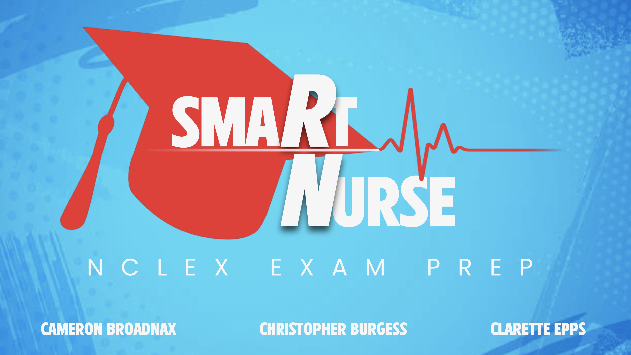
A mobile test prep game for Registered Nursing students preparing to take the NCLEX exam.
GitHub - ksu-hmi/smaRt_Nurse: Test Prep game for Registered Nursing students preparing to sit for the NCLEX exam

Slide 2


The Idea
Team had a Nurse who used different study materials to prepare for NCLEX-RN exam back in 2018.
NCLEX- RN: National Council Licensure Examination for Registered Nurses
Develop a tool that would help prepare Nursing students for the exam that was easy to access and use during the day
Nursing Concepts: Pharmacology, Basic Skills, Dosage Calculations, Anatomy

Slide 3

Source Code Found
Medicine Quiz: https://github.com/Viincenttt/medicine-quiz
Anatomy Game: https://github.com/ksu-hmi/Anatomy-Game
Multiple Choices: https://github.com/whymehin/Multiple_Choices/blob/master/multiple_choices.py
Fill in the Blank: https://github.com/amarch07/fill-in-blanks
GradeTracker.py: http://localhost:8888/edit/Documents/GitHub/pythonteachingcode/1%20gradetracker/GradeTracker.py

Slide 4
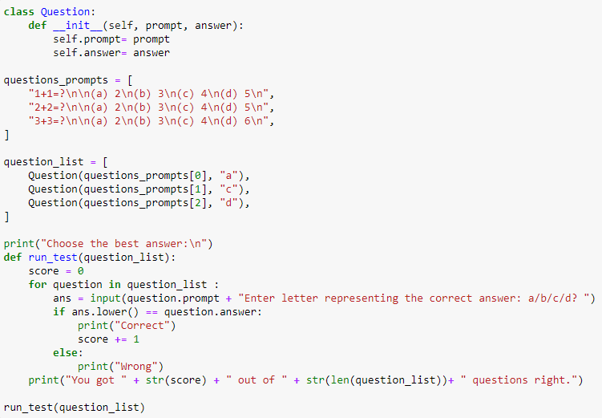
Sample of the Source Code Used
Multiple Choices Game

Slide 5
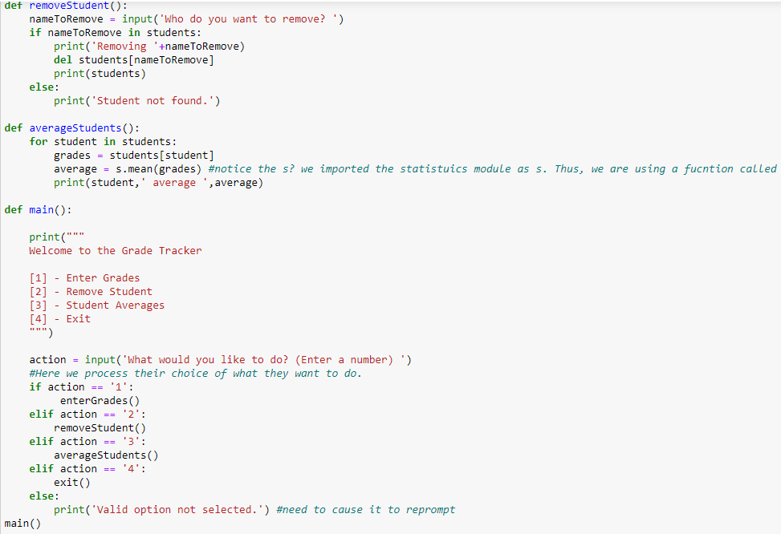
Sample of the Source Code Used
GradeTracker

Slide 6
Project Development
We all had similar ideas
We knew that we wanted to develop a game.
The scope of the application was to provide the user with the ability to take a multiple-choice test and the correct and incorrect answers would be displayed, while also providing the percentage of correct answers.
What surprised us was how easy it was to code – made a new song!
The scope changed as we excluded the intensity level in the interest of time.
.

Slide 7
Roadblocks and Challenges
Formatting Challenges
Output: You got 2 out of 9 questions right.
You need to review the following questions ['1. What is is the correct meaning for angio?\n\n(a) mouth\n(b) water\n(c) lung\n(d) vessel\n', "2. What is the prefix for 'above normal'?\n\n(a) poly\n(b) hypo\n(c) hyper\n(d) mega\n", "3. What is the prefix for 'below normal'?\n\n(a) trans\n(b) semi\n(c) hypo\n(d) post\n", "4. The suffix 'ectomy' refers to?\n\n(a) condition\n(b) incision\n(c) paralysis\n(d) growth\n", "5. 'Skin' is the meaning of what root word?\n\n(a) derm\n(b) oro\n(c) myo\n(d) cyano\n", '6. What is the suffix for inflammation?\n\n(a) tomy\n(b) itis\n(c) scope\n(d) osis\n', '1+1=?\n\n(a) 2\n(b) 3\n(c) 4\n(d) 5\n']
Code to Fix Output Format
#this code will create a new review list and replace the \n with two spaces
new_reviewlist = [item.replace('\n', ' ') for item in need_to_reviewlist]
#this code will create another new review list that will separate the questions to be reviewed and put them on new lines
new_line_reviewlist = '[' + ',\n'.join(new_reviewlist) + ']'

Slide 8

DEMO
smaRtNurse - Jupyter Notebook

Slide 9


What’s Next smaRtNurse
Create a “Premium” version that will unlock more questions, categories, and rationales for both right & wrong answers
Include the level of intensity challenge
Want to mimic the set up of the real NCLEX-RN exam
Determine how many question one takes in category based on percentage right/wrong
Provide links and literature that explain Nursing concepts

